Slide 1




Extended SecOps: Chronicle-Sniffer
A scalable Wireshark-to-SecOps pipeline on Google Cloud Platform.
Designed for robust, event-driven network traffic capture and security analytics.
Scalable and Reliable Services 2025
Filippo Lucchesi

Slide 2
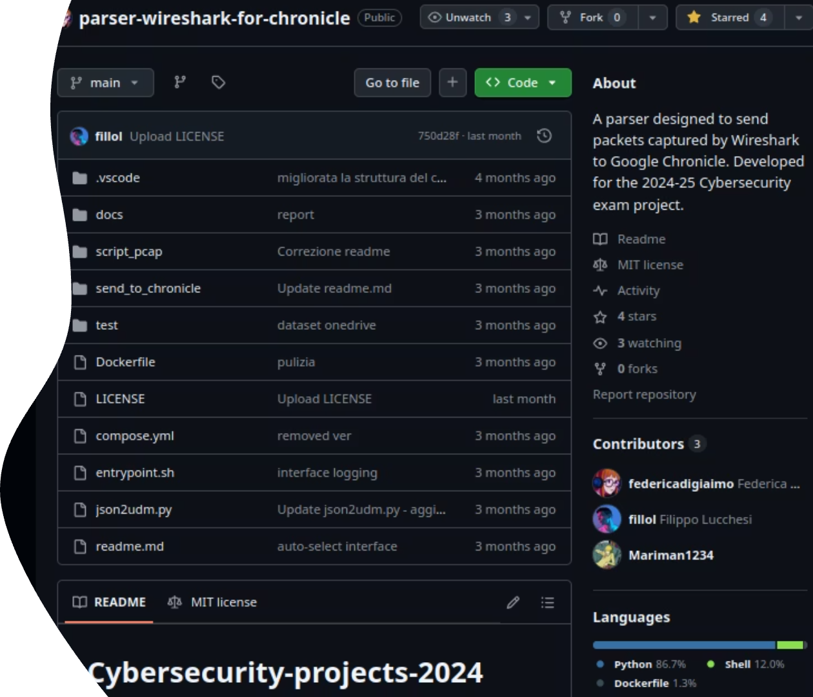
Origins of the project
Autonomous proposal derived from my Cybersecurity exam's project "Parser Wireshark for Chronicle"
Enhanced with cloud-native architecture and enterprise-grade security operations capabilities
Not anymore a local script, now a complete extension to Google SecOps

Slide 3





Key Features & Enhancements
Hybrid Capture Model
Dockerized tshark sniffer for on-premises deployment with automatic PCAP rotation and cloud upload.
Serverless Processing
GCP Cloud Run service transforms network data into Unified Data Model format.
Optimized Transformation
Streaming JSON parsing handles massive outputs within Cloud Run's memory constraints.
Secure by Design
Implements IAM least-privilege principles and OIDC-authenticated invocations.

Slide 4
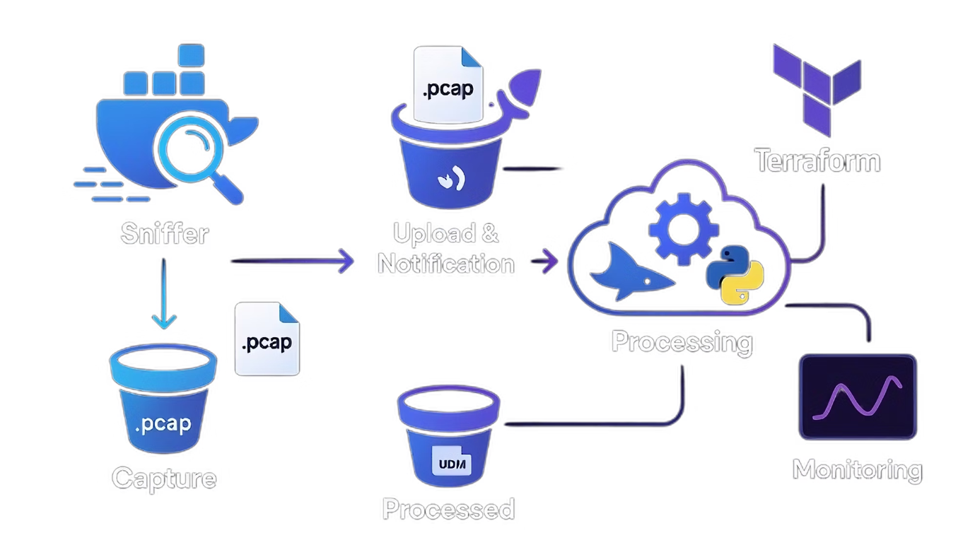
Architecture Overview

Slide 5




Architecture Overview
Capture & Notify
Sniffer container runs tshark, rotates PCAPs, uploads to GCS, and notifies Pub/Sub
Trigger & Process
Cloud Run service downloads PCAP, converts to JSON, maps to UDM format, and uploads results
Error Handling
Dead-letter topics capture failed messages after multiple retries
Observability
All logs sent to Cloud Logging with metrics available in Cloud Monitoring

Slide 6

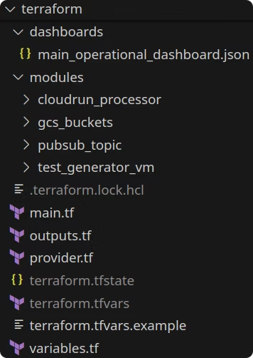
Terraform Modules
1
cloudrun_processor
Deploys PCAP processor as Cloud Run service with resource limits and health probes
2
gcs_buckets
Provisions two GCS buckets: one for incoming raw PCAP files and another for processed UDM files
3
pubsub_topic
Creates Pub/Sub topic for notifications and dead-letter topic for failed messages
4
test_generator_vm
Optional GCE instance to simulate on-premises environment for testing

Slide 7




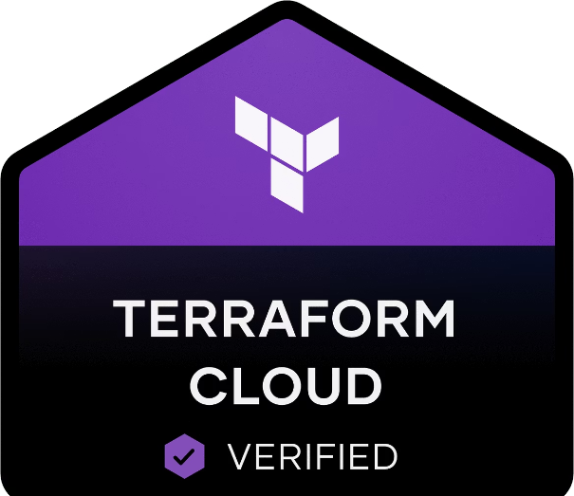
Terraform Implementation
Modular Design
Variable Definition
Each submodule maintains consistent file organization enabling easy maintenance and reusable infrastructure components.
Specific configurations defined in terraform.tfvars following official standards and guidelines.
Configuration Management
Standard Structure
Follows Terraform best practices with main.tf, outputs.tf, and variables.tf files for root and all four submodules.
Clear separation between variable declarations and actual values ensures secure and flexible deployment across environments.

Slide 8
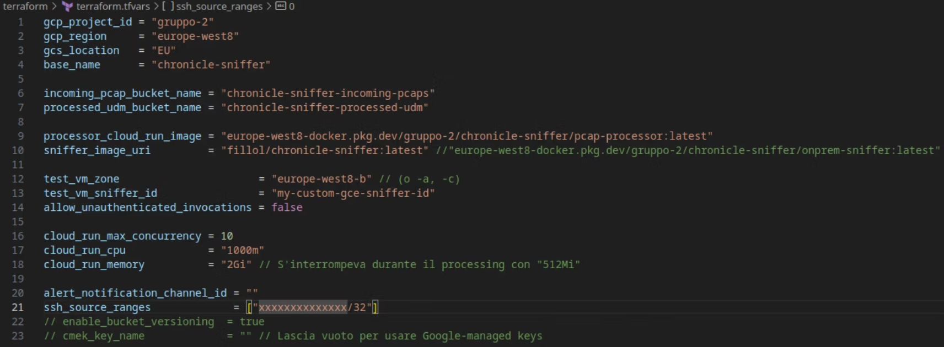
Terraform.tfvars
All "personalized code" is defined in a tfvars file, fooling Terraform's guidelines

Slide 9



Sniffer Container Implementation
Dockerfile Setup
Based on Google Cloud SDK with tshark, procps, and iproute2 installed.
Network Capture
Detects active interface and runs tshark with configurable rotation settings.
Cloud Integration
Uploads completed PCAPs to GCS and publishes notifications to Pub/Sub.
The container includes heartbeat monitoring and graceful shutdown handling.

Slide 10
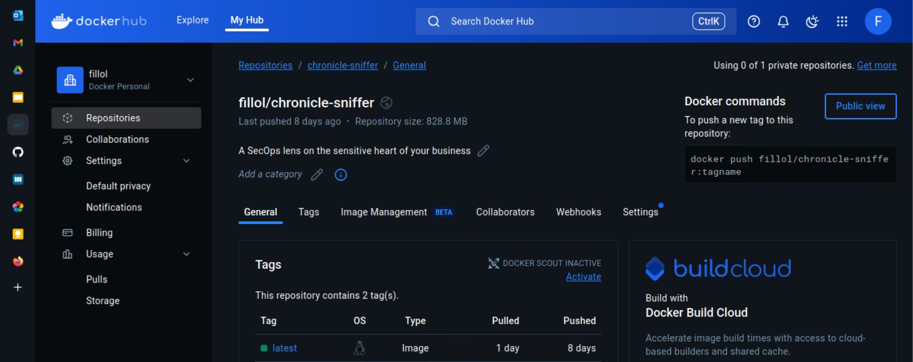
Sniffer: easy deployment
On-prem Container is public on DockerHub:

Slide 11
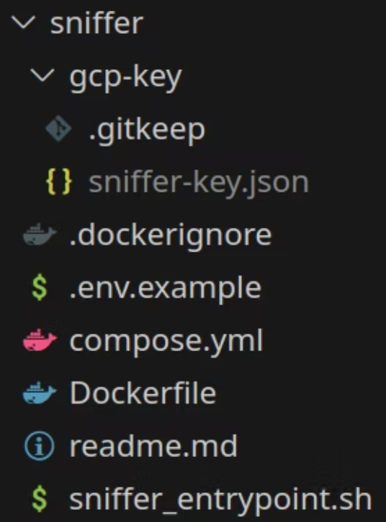
Sniffer: structure
Directory hierarchy:
Service account credentials: key.json
.env example (to compile your own)
readme for sniffer documentation/usage

Slide 12
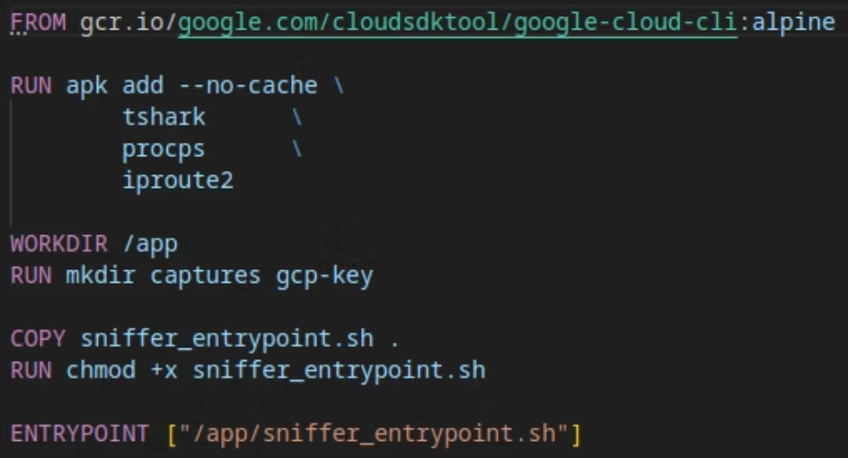
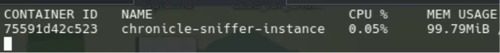
Sniffer: Dockerfile
Lightweight Alpine Image…
For a very light container:
(output of: $ docker stats )

Slide 13
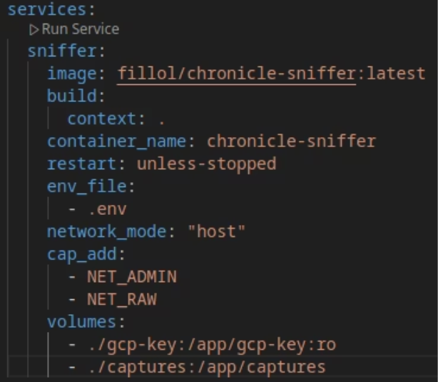
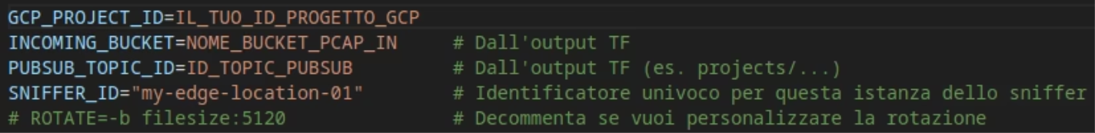
Sniffer: simplest way to start on edge
Docker compose.yaml
to start the container on premises
People only need to compile .env and run:
$ docker compose up -d
Docker .env

Slide 14
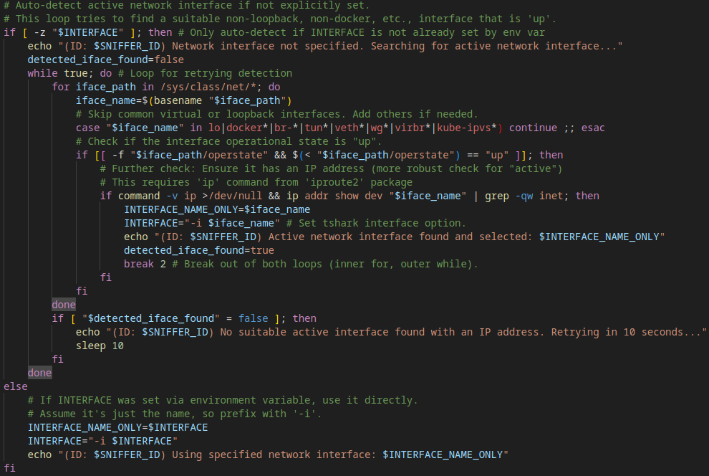
Sniffer: interface
At startup, the container automatically searches for a valid network interface to sniff on.
(if not provided)
It does this by iterating through /sys/class/net and excluding common virtual ones.

Slide 15
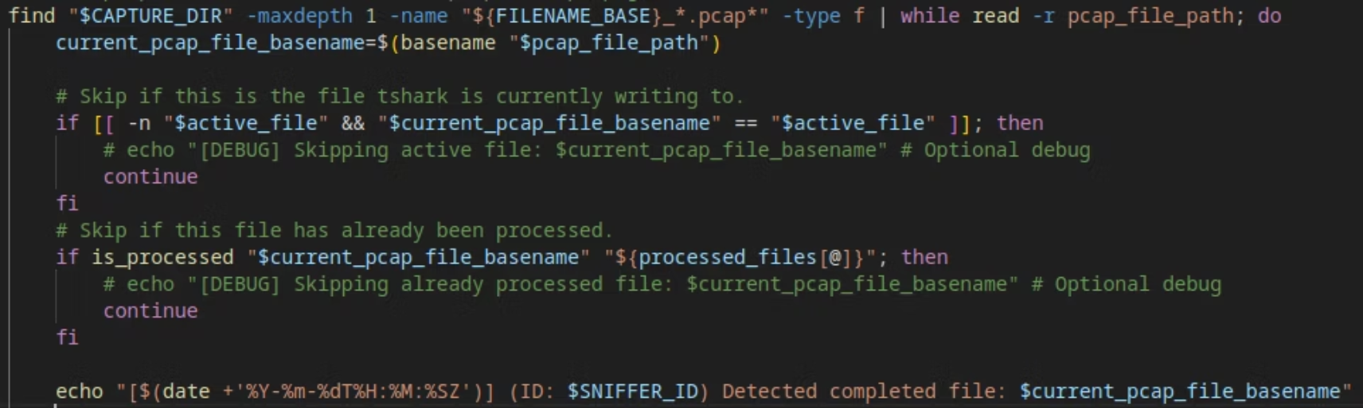
Sniffer: entrypoint
To find completed pcap…

Slide 16
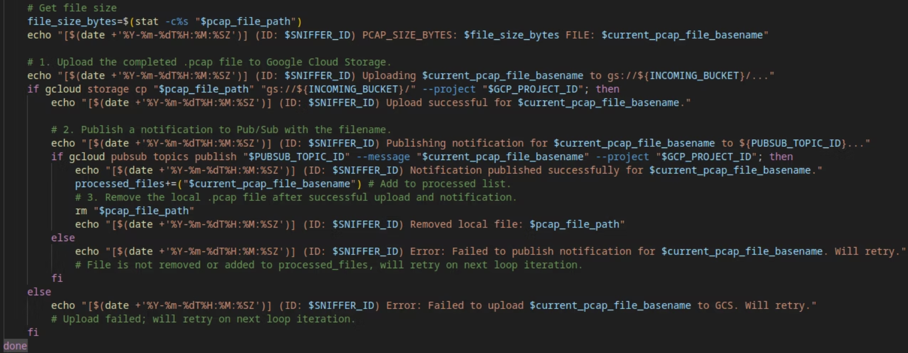
Sniffer: entrypoint
And upload them to GCP

Slide 17
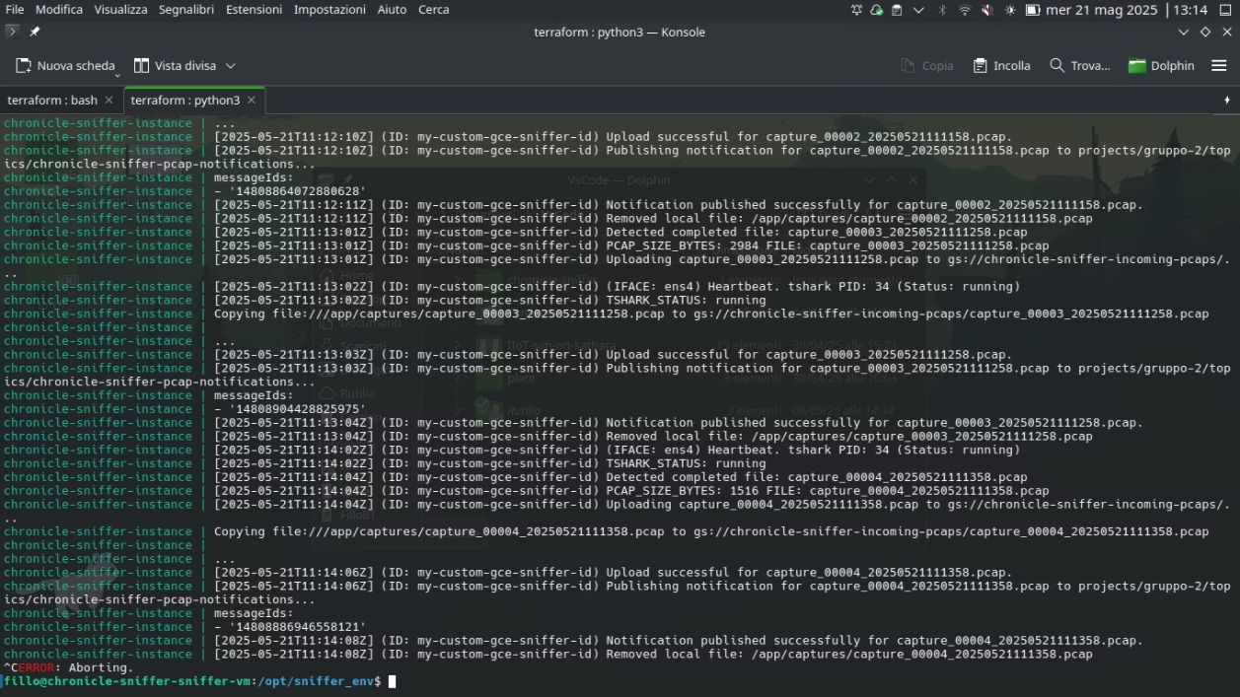
Sniffer: running…
Output of: $docker compose logs -f on test-VM

Slide 18
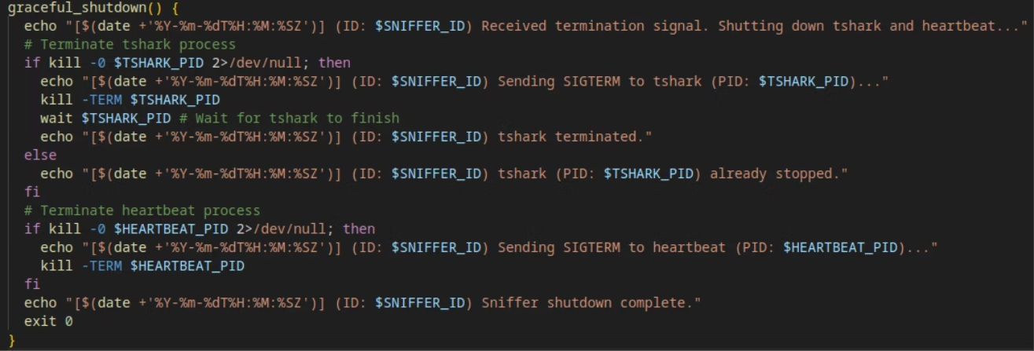
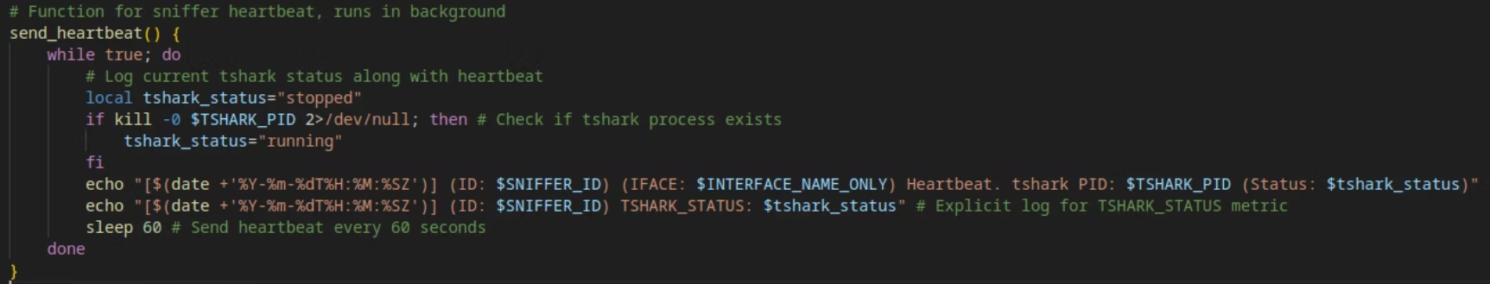
Sniffer: to ensure consistency…

Slide 19
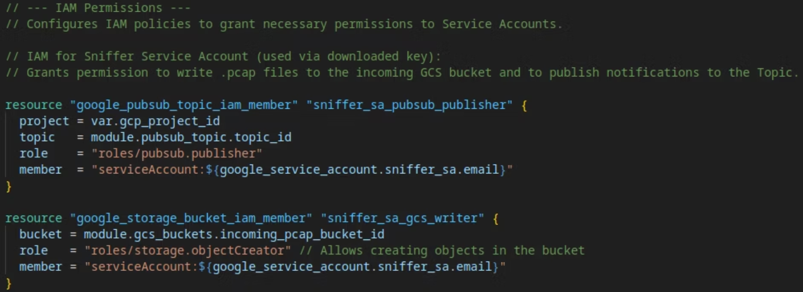
Sniffer: IAM

Slide 20








Cloud Run Processor Implementation
Receive & Download
Convert to JSON
Flask app receives Pub/Sub notifications and downloads PCAP from GCS.
Executes tshark to transform PCAP into raw JSON representation.
Upload Results
Transform to UDM
Uploads processed UDM JSON to output bucket and logs metrics.
Streams JSON with ijson library to create standardized UDM format.

Slide 21
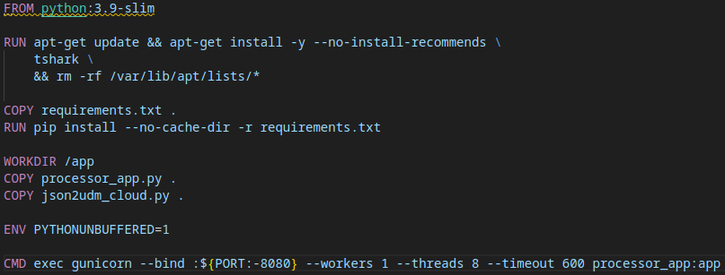
Processor: Dockerfile
Copying 2 main files: the entrypoint and the cybersecurity project’s parser

Slide 22
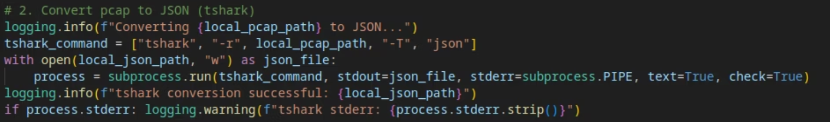
Processor.py (Cloud Run entrypoint)
Cloud Run waked up by Pub/Sub notification (when a pcap is available)
First raw conversion to JSON…

Slide 23
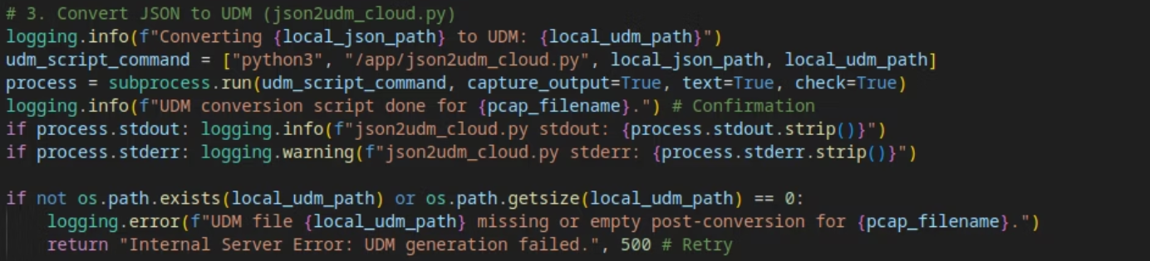
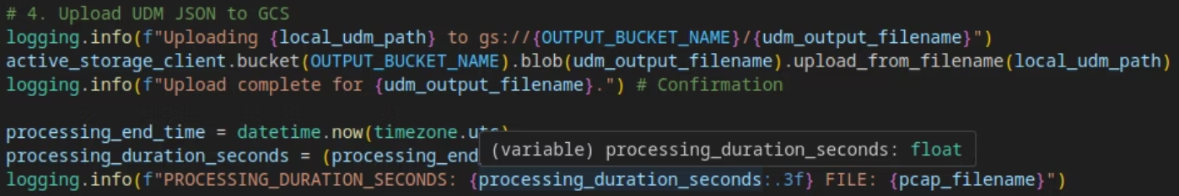
Processor.py
Then the UDM-compliant conversion with json2udm.py (from cybersecurity project)
And the upload to completed bucket

Slide 24
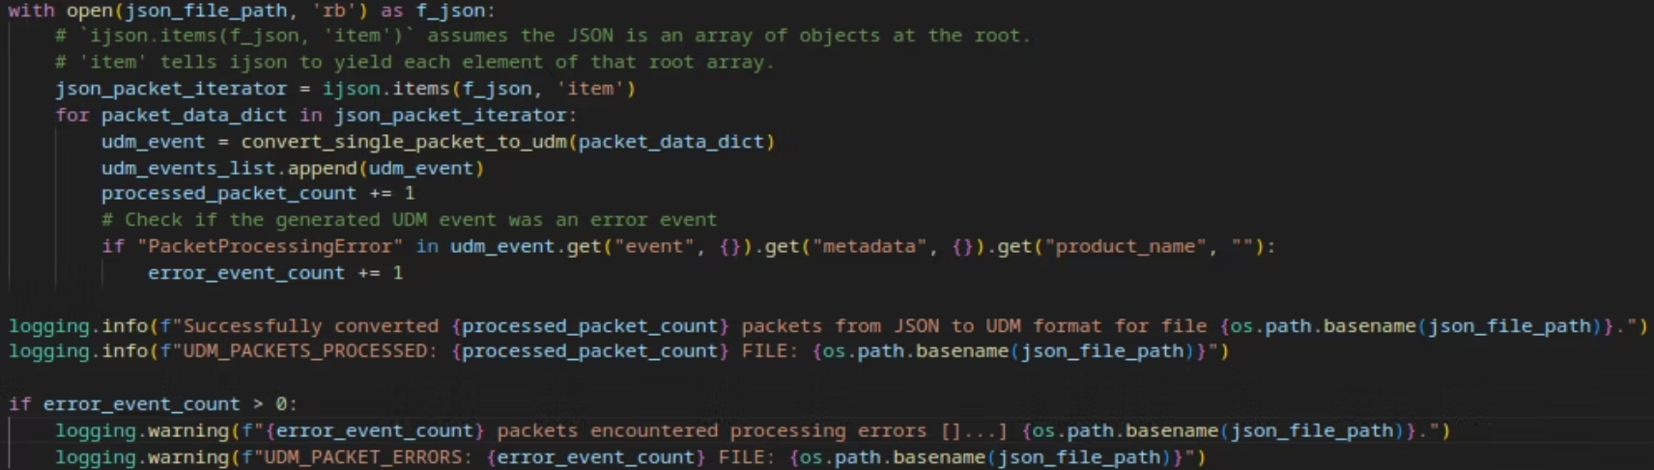
Json2udm_cloud.py
Uses a "small version" of old script on a packet at time, reading them as a stream

Slide 25
From Local Batch to Cloud-Native Streaming
Original Approach
Cloud Improvements
Load entire JSON file into memory
Stream processing with ijson
Process all packets at once
Packet-by-packet handling
Only local file operations
Enhanced error recovery
Slower
Refined UDM structure
These adaptations transformed a local tool into a scalable, cloud-native component.

Slide 26
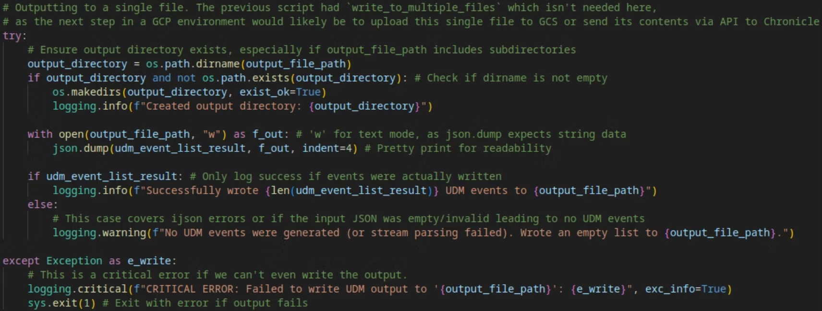
Json2udm_cloud.py: output

Slide 27
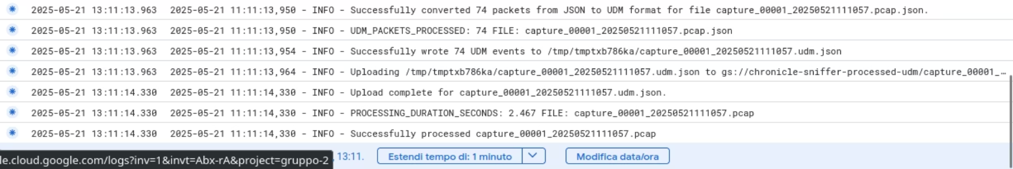
Processor: GCP logs
Cloud Run Log's Snippet on Google CLoud Platform

Slide 28
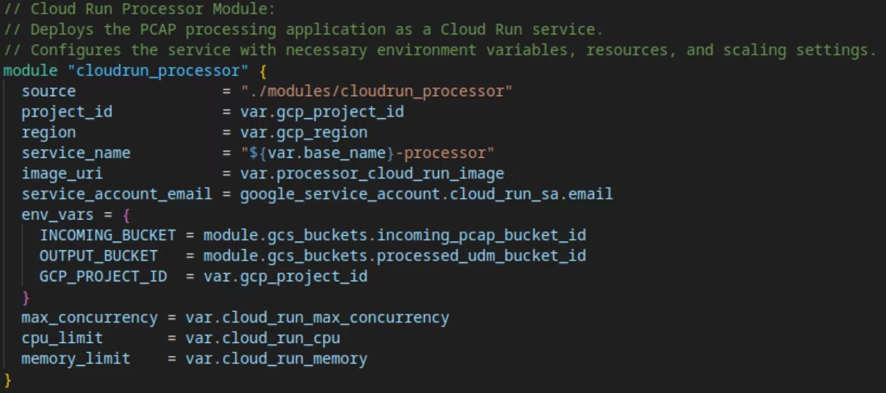
Processor: resource definition
a snippet of main.tf

Slide 29
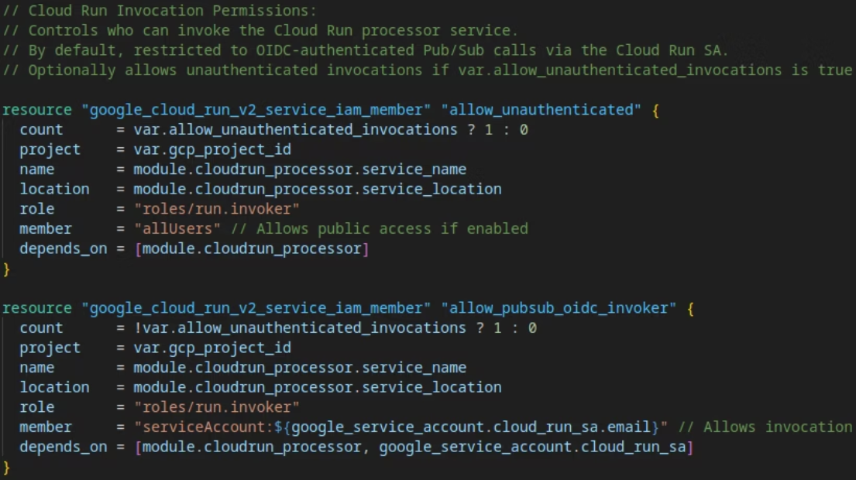
Processor & Pub/Sub: IAM
var allow_unauthenticated_invocations :
Authenticated Access
Default behavior
Pub/Sub calls verified through Cloud Run service account.
OIDC token validation
Unauthenticated Access
Public endpoint access
Simplified testing

Slide 30
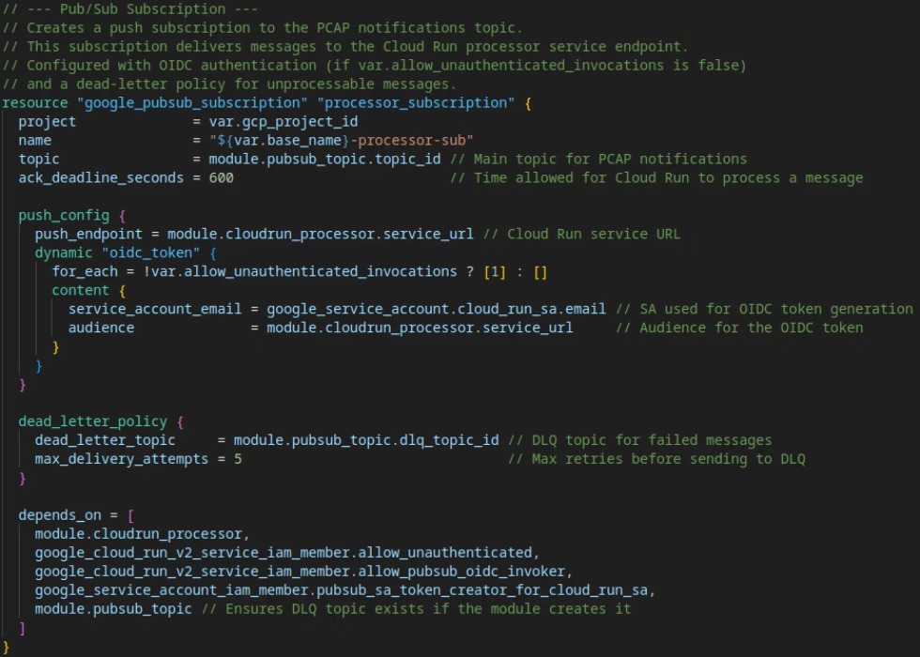
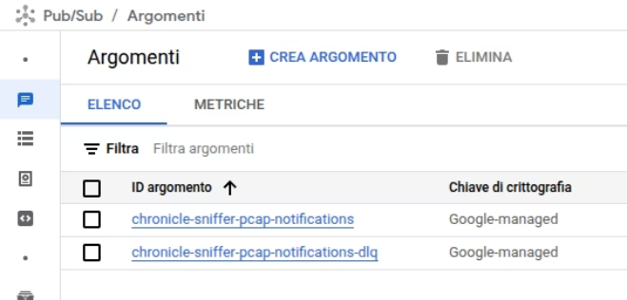
Pub/Sub topics
Normal push
&
Dead Letter Queue

Slide 31
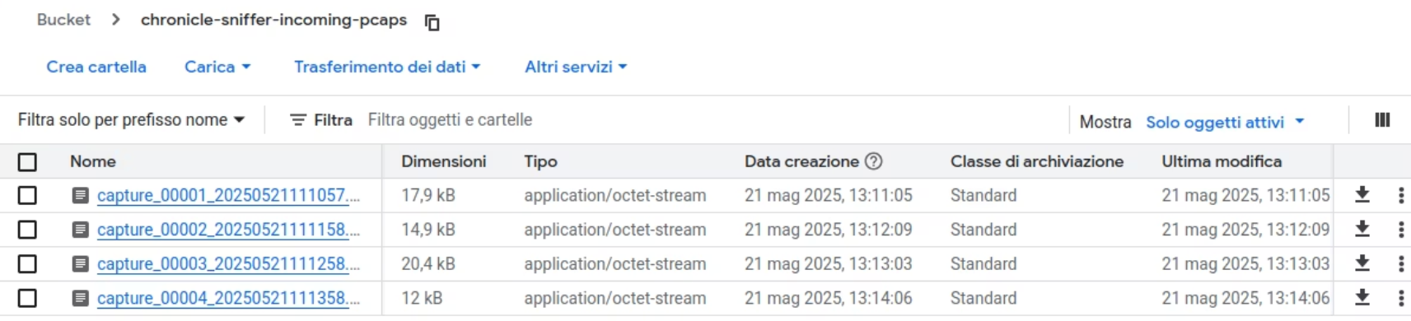
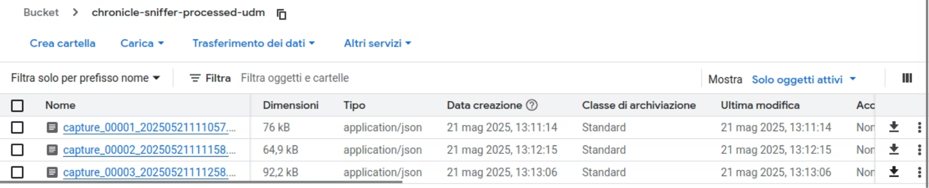
GCP: buckets

Slide 32




TestVM: validates pipeline through realistic simulation
This Terraform-defined component replicates on-premises edge environments where the sniffer operates. It uses tcpreplay to replay PCAP files and hping3 to simulate network attacks like SYN floods.
VM Initialization
Startup script configures Docker environment with GCP credentials and network settings
Traffic Generation
Tools like tcpreplay and hping3 create controlled network scenarios for testing
Attack Simulation
SYN flood attacks test sniffer response to anomalous traffic patterns
End-to-End Validation
Complete pipeline testing from packet capture to UDM format conversion

Slide 33
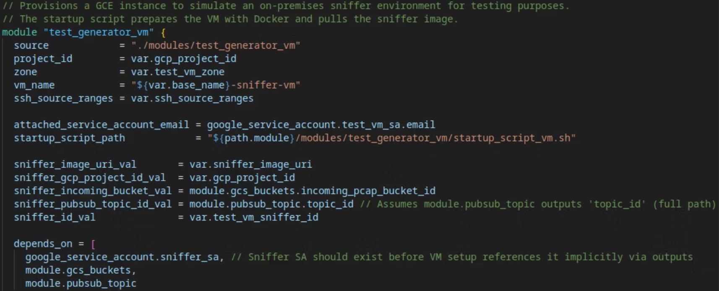
TestVM: Resouce definition
a snippet of main.tf

Slide 34
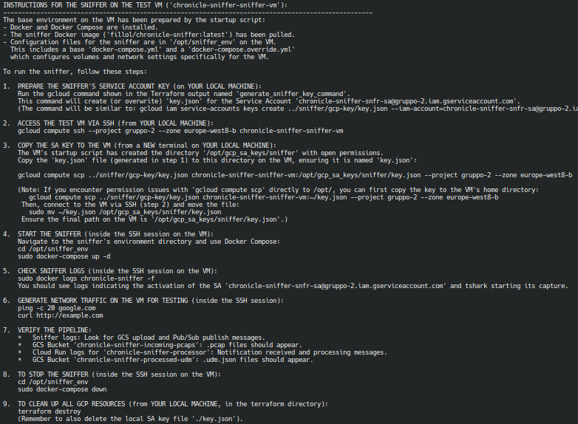
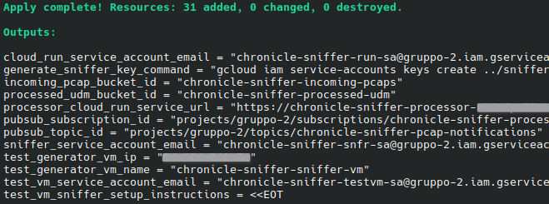
Easy testing
Output of:
All required values are printed, thanks to the definitions in outputs.tf
Additionally, you'll find a small “how-to” guide
for testing the project with the TestVM:

Slide 35
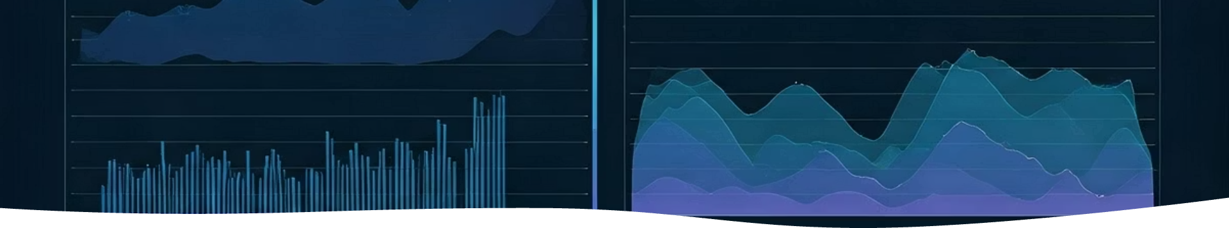



Observability and Monitoring
Cloud Logging
Structured logs from sniffer and processor centralized in Google Cloud Logging.
Log-Based Metrics
Custom metrics track heartbeats, file operations, packet counts, and errors.
Operational Dashboard
Comprehensive view of pipeline health using Monitoring Query Language (MQL).

Slide 36
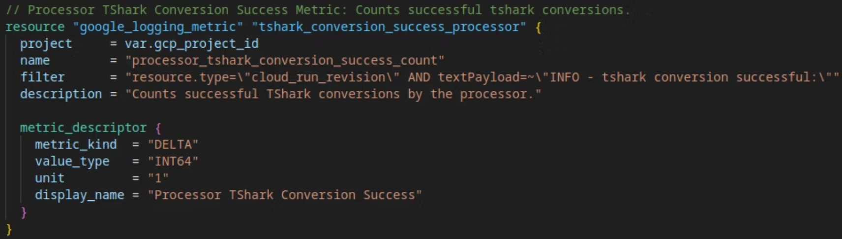
Log metrics in Terraform
an example of metric defined in terraform's main.tf

Slide 37
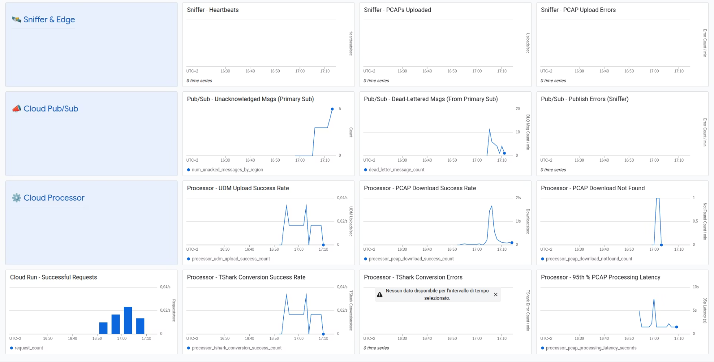
Operational Dashboard
Deployable via terraform, exported in JSON
Deployable via terraform, exported in JSON

Slide 38
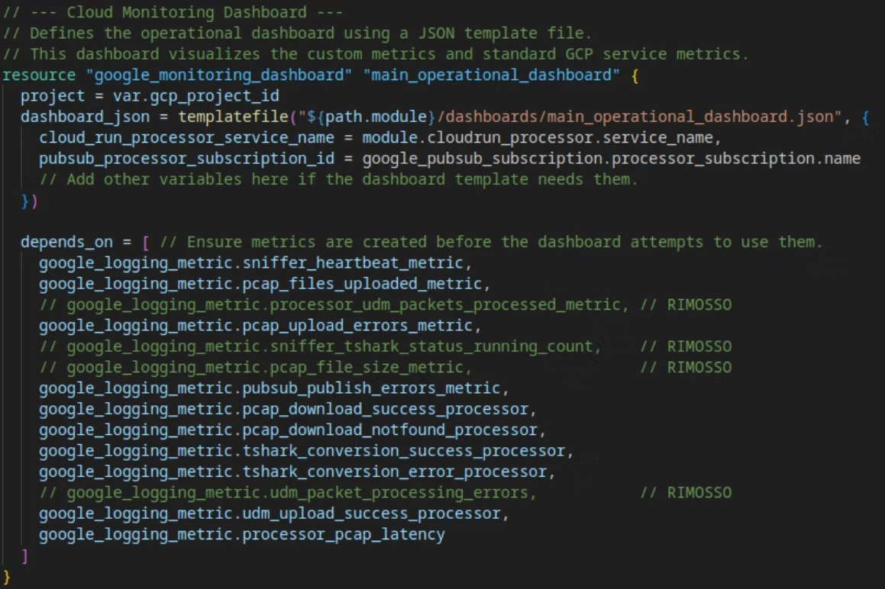
Operational Dashboard: resource definition

Slide 39
Security Considerations
This pipeline applies defense-in-depth security with least privilege IAM and granular service account permissions.
Network isolation safeguards edge sniffers from unauthorized access. Containers are scanned before deployment, and data transmissions are encrypted for integrity.
The system features least-privilege IAM, OIDC-secured invocations, secure key management, and protected storage. Firewall rules limit access to specific IP ranges (for test-vm access).
The Test Generator VM supports threat simulation using hping3 and tcpreplay for validating detection.
Comprehensive logging audits security events. Dead letter queues prevent data loss.

Slide 40







One last (complete) Overview
Test-VM
Google SecOps

Slide 41








Educational Value & Cloud-Native Principles
Managed Services
Leveraging GCP's services reduces operational overhead
Infrastructure as Code
Terraform ensures consistent, repeatable deployments
Scalability & Decoupling
Event-driven architecture with independent components
Security & Observability
OIDC authentication and comprehensive monitoring

Slide 42
Project Conclusion & Key Outcomes
This project successfully demonstrated the practical implementation of modern cloud-native principles, culminating in a scalable, secure, and observable packet capture to Chronicle pipeline
Core Achievements & Demonstrations:
Cloud-Native Architecture: From local batch to optimized streaming
Resilient Design: Event-driven (Pub/Sub) for decoupling; Serverless (Cloud Run) for auto-scaling
Efficient Resource Management: ijson streaming for cloud memory adaptation
Industry Best Practices: Security (Least Privilege IAM) & end-to-end monitoring
Thank You.
Project by Filippo Lucchesi

